Slide 1
Understanding an Android Activity

Slide 2
AGENDA
Understanding an activity
Starting an activity
Passing information between activities
Understanding intents
Understanding the activity lifecycle

Slide 3
Understanding an activity
an activity:
is an application component that provides a screen with which users can interact in order to do something, such as dial the phone, take a photo, send an email, or view a map. Each activity is given a window in which to draw its user interface. The window typically fills the screen, but may be smaller than the screen and float on top of other windows.

Slide 4
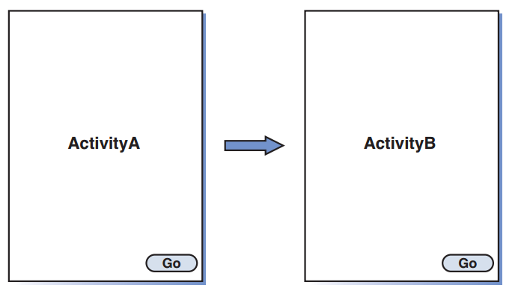
Starting an Activity
Starting One Activity from Another:

Slide 5
Starting an Activity
Starting One Activity from Another:
create a project that have two activities, one activity starts the other activity.
Follow the same steps listed in Hour 1 to create a new project:
Choose File, New Project.
Name the project and enter a Package Name.
Choose to create a Blank Activity.
Use ActivityA for the Activity Name and activity_layout for the Layout Name.
Click Finish to create the project.

Slide 6
Starting an Activity
Starting One Activity from Another:
To create a second activity, you make a copy of ActivityA
Right-click ActivityA and choose Copy.
Highlight the package, right-click, and choose Paste.
Call the second activity ActivityB .
To create button in activity_layout
Using the visual tools to drag, add the button to the activity_layout by dragging and dropping it from the palette to the layout canvas.
Change the Text property of the button to contain the word Go

Slide 7
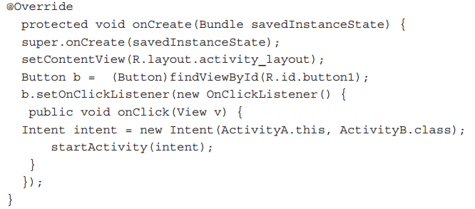
Starting an Activity
Starting One Activity from Another:
The code for launching ActivityB from ActivityA, you override the activity’s onCreate() method and add code to handle the button click.

Slide 8
Starting an Activity
Starting One Activity from Another:
To run the app:
you must add ActivityB to the project’s AndroidManifest.xml file.
Every application must have an AndroidManifest.xml file. It presents essential information to the Android system about the application, including information about the available activities.
To add a reference to ActivityB to the AndroidManifest.xml file, find AndroidManifest.xml with the Hour2App project and select it.

Slide 9
Starting an Activity
Starting One Activity from Another:
the code in ActivityB to have the TextView in each activity identify which activity is being displayed, and wire the Button in ActivityB to start ActivityA.

Slide 10
Starting an Activity
Starting One Activity from Another:
After switching between ActivityA and ActivityB a number of times, if you use the Back button in the emulator, the app shows the activities in reverse order. That might not be the behavior that you expected or wanted!

Slide 11
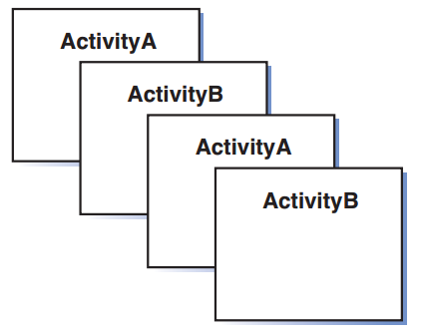
Starting an Activity
Understanding the Back Stack:
As an activity is started, it is added to the “back stack” for the application. The back stack is a stack of activities. The first activity is added to the stack and all subsequent activities are added to the stack when they start.

Slide 12
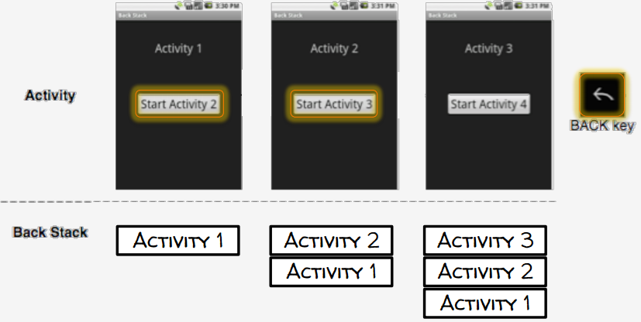
Starting an Activity
Understanding the Back Stack:

Slide 13
Starting an Activity
Understanding the Back Stack:
Update code to set two intent flags when you start each activity.

Slide 14
Starting an Activity
The Launch Activity:
the question: How do you indicate that the app should start with ActivityA?
Remember that the basic code for ActivityA was generated for you. The AndroidManifest.xml file was also generated. The manifest file indicates the activity to launch when the app starts, as shown

Slide 15
Passing Information Between Activities
The two cases for passing data between apps are the following:
Passing data from one activity to another; for example, ActivityA passes data to ActivityB.
The first activity requests data from a second activity. So, ActivityA requests data from a new activity called ActivityC, and ActivityC returns data to ActivityA.

Slide 16
Passing Information Between Activities
Using Extras and Bundles:
Data can be added to the intent that starts the activity.
Extra: Data is added to the intent as “extra” data. Data types such as strings, integers, and booleans can be passed as extras.
bundle: Abundle of data and more complex data types can also be passed.

Slide 17
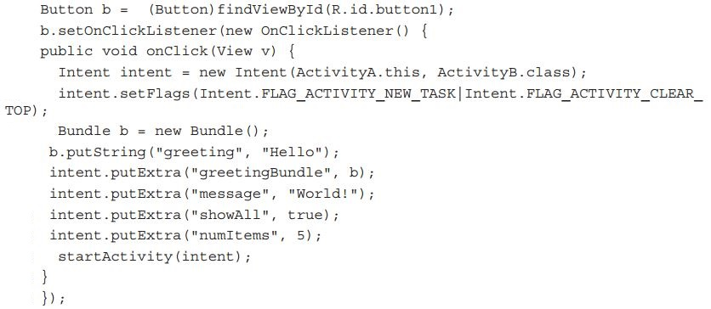
Passing Information Between Activities
Using Extras and Bundles:
Adding Extra Data to an Intent:

Slide 18
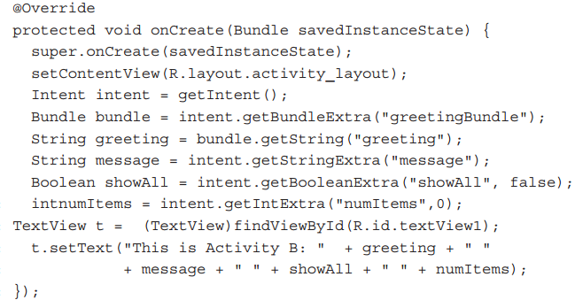
Passing Information Between Activities
Using Extras and Bundles:
Accessing Extra Data from an Intent

Slide 19
Passing Information Between Activities
Returning a Result: Using StartActivityForResult
ActivityA uses startActivityForResult() and must handle the result and any data provided by ActivityC. ActivityC might or might not return data, but it will generally provide a result to ActivityA.

Slide 20
Passing Information Between Activities Using StartActivityForResult
Create ActivityC to Handle Data Requests:
Copy activity_layout.xml to a file called activity_c_layout.xml.
Modify the new layout file using the visual editor. There should be one EditText and two Buttons : one for Send Data and the other for Cancel.
Create an activity called ActivityC. (You can copy ActivityA to start.)
Update ActivityC to use the new layout in setContentView .
Refer to the buttons you created in the activity code.
Add ActivityC to the AndroidManifest.xml file.
Update the basic ActivityC code as shown.

Slide 21
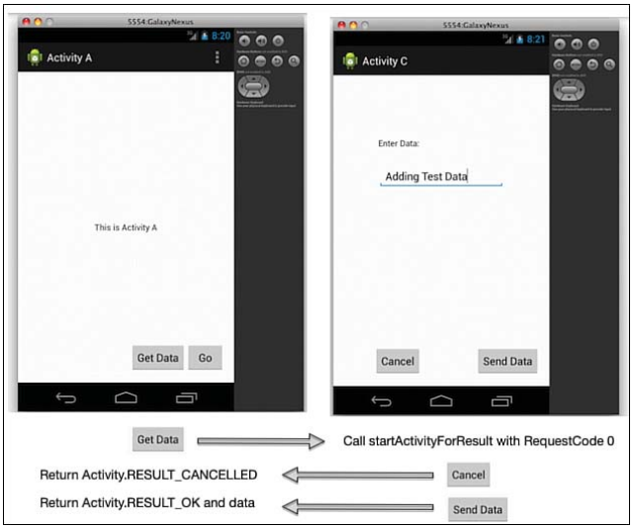
Passing Information Between Activities Using StartActivityForResult

Slide 22
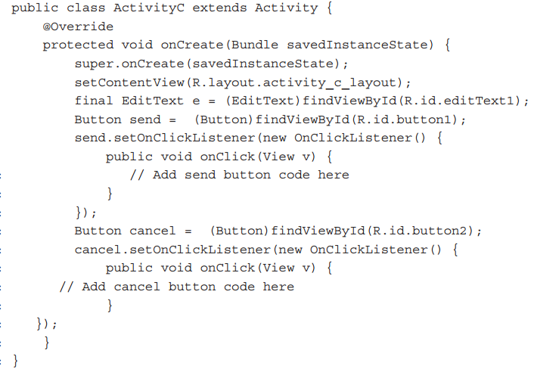
Passing Information Between Activities Using StartActivityForResult

Slide 23
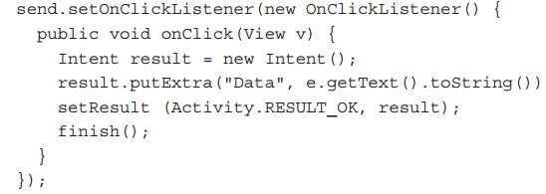
Passing Information Between Activities Using StartActivityForResult
Returning a Result from an Activity
Returning No Result from an Activity

Slide 24
Passing Information Between Activities Using StartActivityForResult
Using StartActivityForResult :
Handling the Result :

Slide 25
Understanding Intents
Intents:
They have been used to start an activity, pass data to an activity, and to request a result from an activity.
explicit intents: which means intents that refer explicitly by class name for the activity that you want to start. In the case of explicit intents, the action to perform is specified by the activity.
implicit intents: Activities can start an implicit intent that does not specify a specific activity, but rather requests an action of some kind. For example, implicit intents can retrieve an image from the file system or take a picture with the camera. The request specifies the action to take, not the activity to run.

Slide 26
Understanding Intents
use of an implicit intent to add the ability to handle Intent.ACTION_SEND for plain text to ActivityB. That means when any activity makes a request to handle Intent.ACTION_SEND , ActivityB will be one of the options. You will be adding this as a new capability for ActivityB.
You will modify ActivityB and change the AndroidManifest.xml file to indicate that ActivityB can handle this intent. You do this by adding an intent filter.

Slide 27
Understanding Intents
Update to ActivityB to handle the ACTION_SEND intent.

Slide 28
Understanding Intents
Now ActivityB is ready to act on any intent for an activity that handles action Intent.ACTION_SEND with type “plain/text.” You can see this work in a number of ways.
Using the browser app, you can share a URL. Figure A shows the Share Page function in the browser. When you select that option, ActivityB appears as an option, as shown in Figure B . The URL provided from the browser ACTION_SEND intent will be displayed in ActivityB as the passed data.

Slide 29
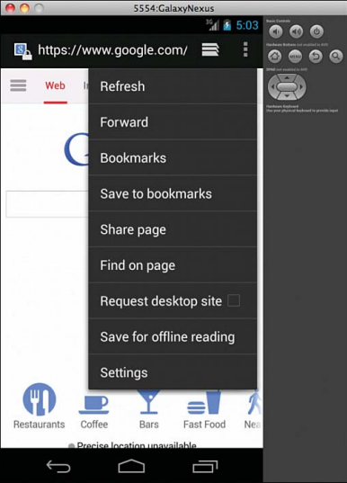
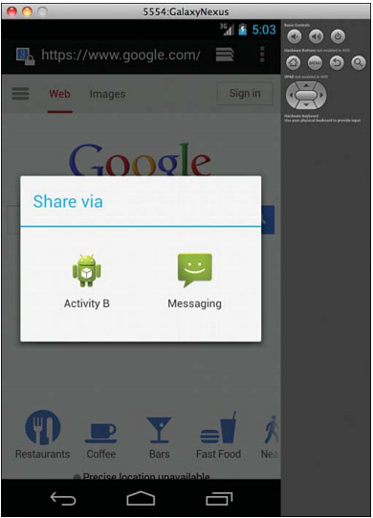
Understanding Intents
Fig. A Fig. B

Slide 30
Understanding the Activity Lifecycle
The Activity Lifecycle:
An activity also has a number of internal states. Activities are created, started, paused, resumed, and destroyed.
The states that an activity goes through are known as the activity lifecycle.
The activity lifecycle includes creating, starting, pausing, resuming, and destroying activities.
The activity lifecycle is important because each point in the lifecycle provides an opportunity to take an action within the activity.

Slide 31
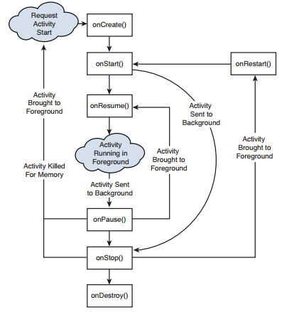
Understanding the Activity Lifecycle
The Activity Lifecycle:

Slide 32
Thank You!

